Slide 1
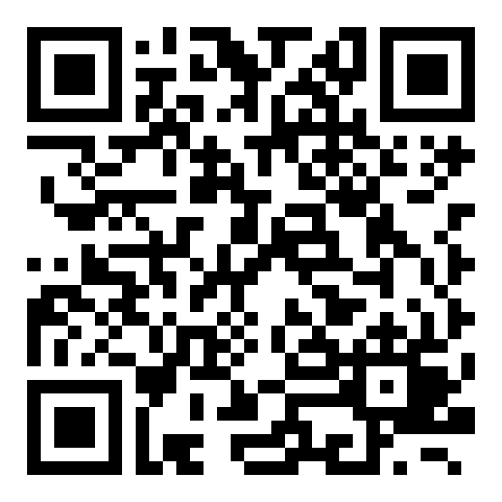
Course evaluation: Tutorat zu Research Design and Methods in Quantitative Research
Evaluation period: 18 - 29 November 2024

